Slide 1



Predictive Modeling for Surgical Outcomes
Sai Teja Pannala, Michael Druga, David Arteaga
ELM-5543-997 | Decision Analysis | Group 13

Slide 2
Project Overview
This project is focused on the TAVR (Trans-catheter AVR) surgery outcomes.
The provided dataset was originally created by a predictive model utilizing preoperative survey data from patients prior to the TAVR procedure then adding the outcome of the surgery if there was a complication
The objective of this project is to develop a predictive model that can assess the likelihood of postoperative complications in surgical patients based on their health metrics and surgery-related variables to aid the surgeon in their risk assessment.
By identifying patients at high risk of complications, the model will support healthcare providers in making informed decisions, optimizing resource allocation, and ultimately improving patient outcomes.
This project uses machine learning to predict stroke occurrences based on clinical and demographic features. By leveraging various machine learning models, this study aims to determine the most effective model for accurately predicting strokes, ultimately assisting in early detection and prevention strategies.

Slide 3

Data Preprocessing
The first step in our process was to perform a data quality report and clean up any issues as well as to perform initial Feature Engineering to provide a quality dataset for the predictive model analysis.
One record has a mis-typed value where a coma was used in place of a decimal, this was manually repaired.
There were 3 instances of missing data that were programmatically inputed using mean values.
Any remaining missing data or NA’s were programmatically omitted.
Headers were repaired programmatically to remove spaces and special characters such as ‘&’ with an underscore.
The descriptive complications were simplified into Boolean and categorical options.

Slide 4
Data Preprocessing
Complications were grouped into discrete categories to determine if any specific category would be more predictable that the others.
The categories for stroke and for permanent pacemaker (PPM) were separately identified for further evaluation.
For this project, we focused on the stroke complication category.
Feature Engineering
Numerical Features: Standardized using StandardScaler to normalize their ranges.
Categorical Features: One-hot encoded using OneHotEncoder to prepare for modeling.
A Column Transformer pipeline was created to streamline preprocessing steps, ensuring uniform handling across all features during model training.

Slide 5
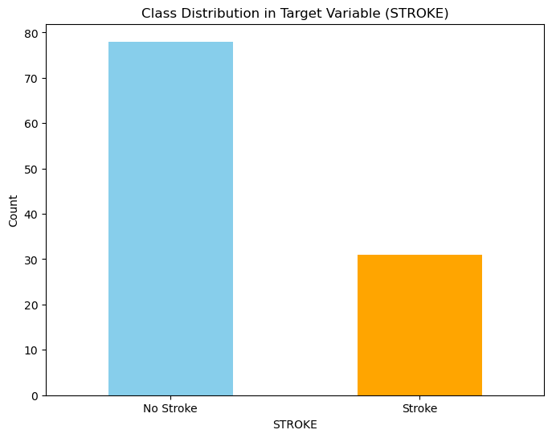
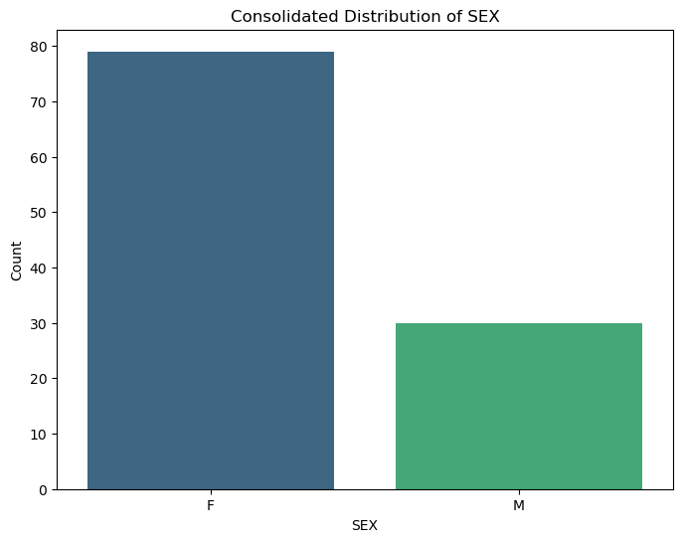
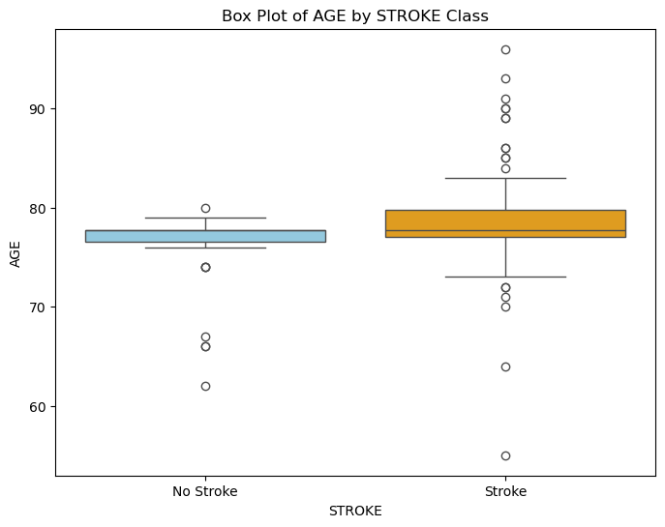
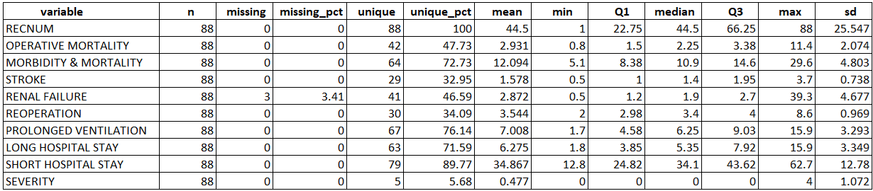
Data Preprocessing
Data Preprocessing
The initial Data Quality report is provided below along with several charts showing the breakdown of data being analyzed:
Notes:
Class Distribution In Target Variable (STROKE): The chart indicates that the majority of patients belong to the “No Stroke” category rather than the “Stroke” category. This imbalance may have an impact on our predictive model. The model might become biased toward predicting “No Stroke” more frequently because it is the dominant class. This could result poor recall for the minority class (”Stroke”). The model might fail to identify patients at risk of stroke, which is critical.
Consolidated Distribution of SEX: The bar for females is significantly taller, indicating that the majority of the dataset consists of female patients. The dataset is heavily imbalanced by gender, this imbalance may impact the model’s ability to generalize predictions across genders, especially for the minority group (males). A predictive model trained on this dataset might be biased toward females, as the model will encounter fewer male samples during training. This might result in poor performance when predicting outcomes for male patients.
Box Plot of AGE by STROKE Class: “No Stroke Class” – The box is narrow, indicating that the ages patients that do not experience a stroke are tightly clustered around the median. The median age appears to be slightly below 80 years. “Stroke Class” – The box is wider, showing a larger spread in the age distribution for stroke cases. The median age is higher than the “No Stroke” class (closer to or above 80 years). There are numerous outliers on both ends, indicating some younger and older patients with stroke. The median age for the “Stroke” class is noticeably higher than the “No Stroke” class, this suggests a strong correlation between age and the likelihood of stroke e.g.: Older patients are at higher risk of stroke, which aligns with known medical insights.
Outliers in the “Stroke” class may represent younger individuals with underlying health conditions that predispose them to stroke.
Age is likely to emerge as an important predictor in our model, especially for identifying stroke cases.

Slide 6
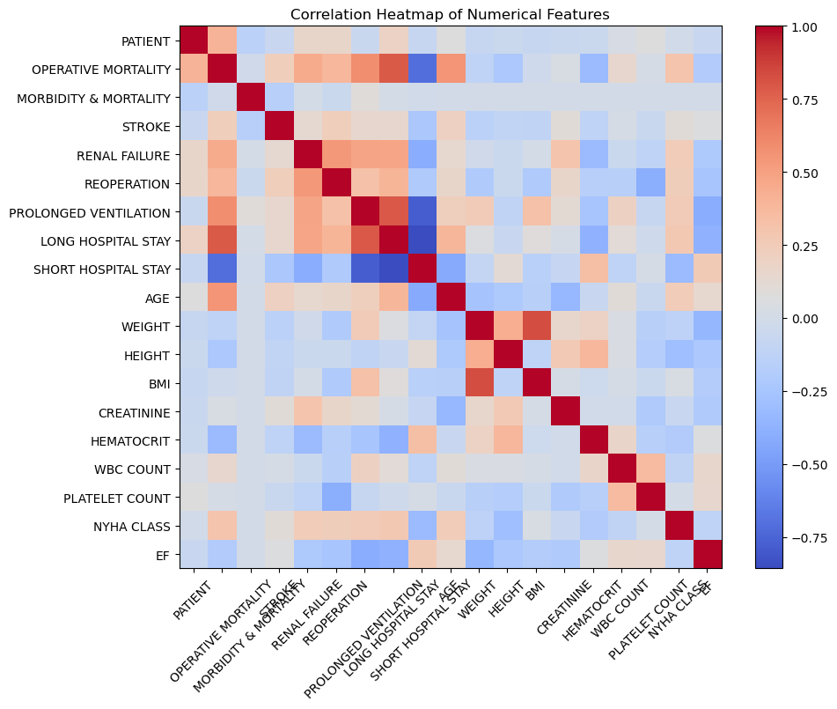
Data Preprocessing
The correlation analysis below is illustrated as a correlation heat map indicating any highly correlated or inversely correlated data on the numerical features.
Highly correlated features (e.g., blood pressure and BMI) were identified and reduced to minimize redundancy.
Insights from correlations guided the feature selection process.
The chart reflects the final configuration after feature selection.
Notes:
Correlation Heatmap of Numerical Features: The diagonal cells (dark red) represent a perfect correlation (value of 1.0).
Strong Positive Correlations:
There is a strong positive correlation in Long Hospital Stay and Prolonged Ventilation suggesting that patients who require prolonged ventilation tend to stay in the hospital longer. Operative Mortality and Morbidity & Mortality – These are highly correlated, which is expected since both are outcome-related variables. Age and Stroke – There appears to be a moderately positive correlation, confirming the role of age in stroke risk.
Strong Negative Correlations:
EF (Ejection Fraction) and NYHA Class – There is a strong negative correlation, higher NYHA class (indicating worse heart function) is associated with EF, which makes clinical sense.
Weak Correlations:
Some features, such as WBC count, Platelet Count, and BMI show little to no correlation with most other variables. This might indicate that these features contribute less to the outcomes and may not be significant in modeling.

Slide 7
Modeling Techniques
The following predictive models were analyzed:
Logistic Regression – This is a simple and interpretable model that can serve as a baseline for the binary classification problem.
Support Vector Machines (SVM) – Highly effective at handling high-dimensional data and performs well when there are relatively few samples.
Linear Discriminant Analysis (LDA) – Reduces the dimensionality of the data and is useful when there are more features than samples.
Random Forest – This ensemble learning model can handle a large number of features and interactions, offering high accuracy and insights into feature importance.
XGBoost – This will be used for its ability to model complex relationships through gradient boosting, making it ideal for non-linear patterns in the dataset.
Neural Networks – If the dataset is large and complex, neural networks could be employed to capture intricate relationships that simpler models might miss.

Slide 8
Modeling Techniques
The SVM, LDA, and Neural Networks techniques were ultimately excluded due to their poor relative performance. Results of Logistic Regression, XGBoost, Neural Networks and Random forest are included for interpretation in this report.
The modeling focused on the prevalence of stroke:
0 (No stroke): Represented the majority of cases.
1 (Stroke): Represented the minority class, requiring techniques like oversampling to balance the dataset.

Slide 9
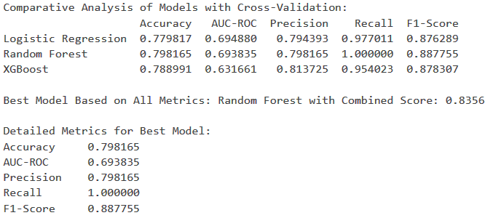
Evaluation Metrics
Each model was evaluated based on:
Accuracy: Overall correctness of predictions.
AUC-ROC: Ability to rank predictions correctly.
Precision: Proportion of correctly predicted positive cases.
Recall: Proportion of actual positive cases identified.
F1-Score: Harmonic mean of Precision and Recall.

Slide 10
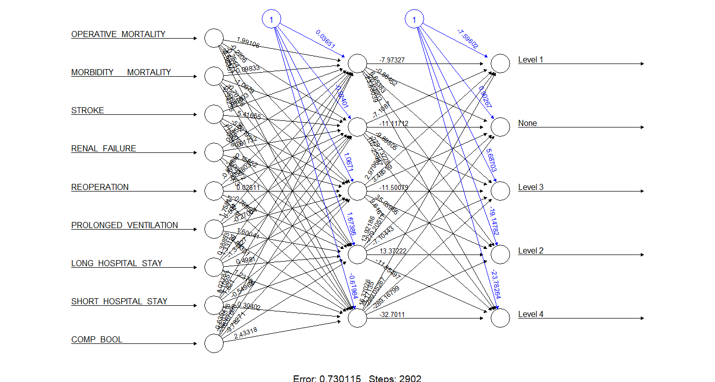
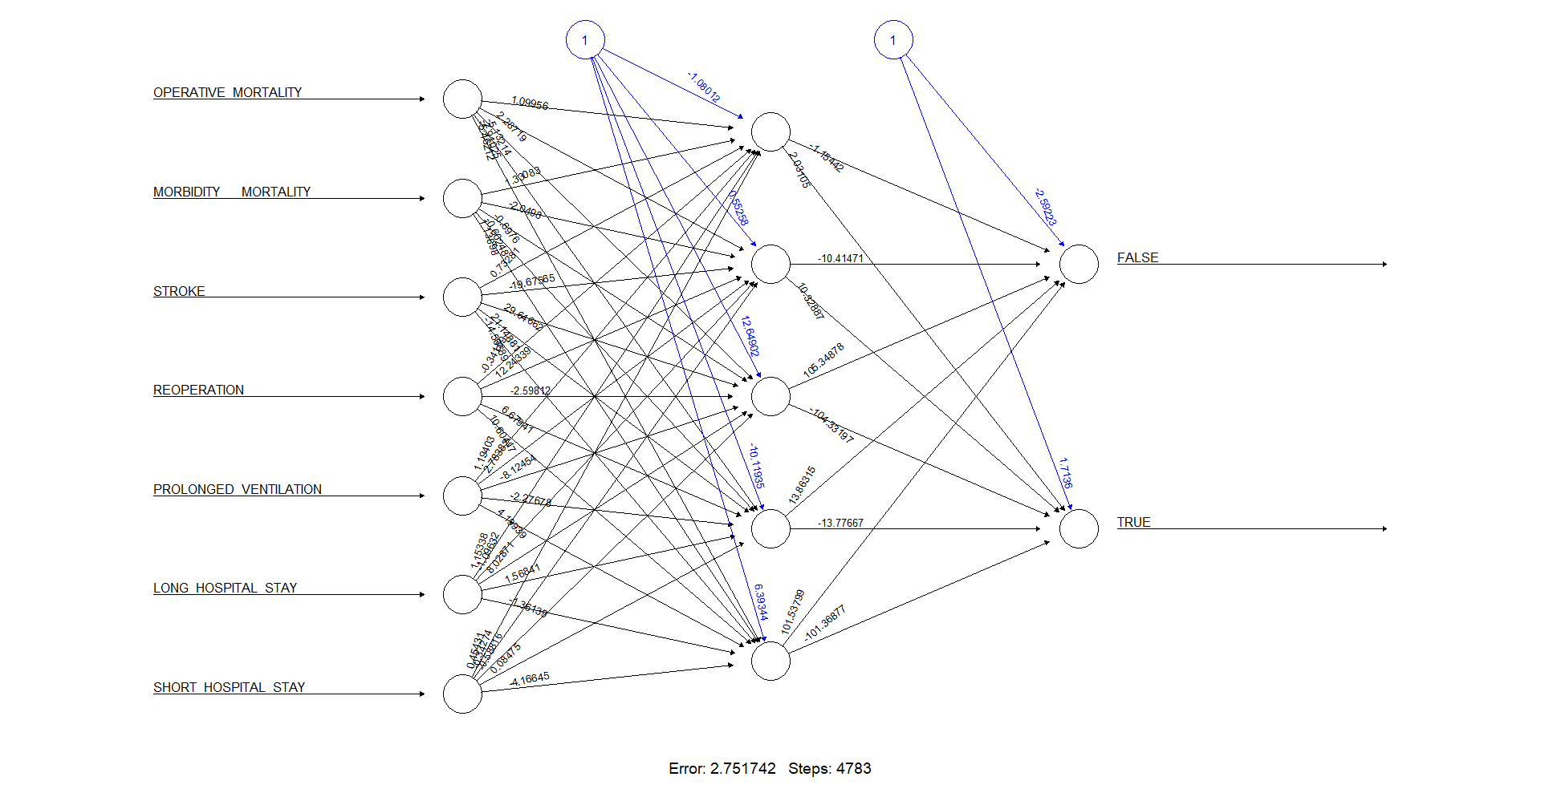
Model Comparison 1
This comparison set shows a Neural Network analysis of the data in two different configurations.
1
The first Neural Network diagram shows the analysis based on a categorical predictor with the potential complications being either ‘None’ or 1 of 4 categories.
The second Neural Network diagram shows the analysis attempting to predict any complication.
2
Both cases did not prove reliable enough for Neural Networks to be further considered, likely due to the low number of data points available within the dataset.
Notes:
This Neural Network analysis was generated in R code using Rstudio with the code below, whereas the remainder of the analysis was performed in Python.
################ Neural Network #####################
library(neuralnet)
dfn <- subset(dataset.surgeryClean, select= c("COMP_BOOL","OPERATIVE_MORTALITY", "MORBIDITY___MORTALITY","STROKE","REOPERATION","PROLONGED_VENTILATION", "LONG_HOSPITAL_STAY", "SHORT_HOSPITAL_STAY"))
dfn$COMP_BOOL <- as.factor(dfn$COMP_BOOL)
intraining <- createDataPartition(dfn$COMP_BOOL, p=.6, list=FALSE)
training <- dfn[intraining,]
validation <- dfn[-intraining,]
# Train the neural network model
nn_model <- neuralnet(COMP_BOOL ~ .,
data = training,
hidden = c(5), # Specify the number of hidden layers and nodes (e.g., 5 nodes in 1 hidden layer)
linear.output = FALSE) # Use FALSE for classification tasks
plot(nn_model)
# Make predictions on the validation data as probabilities for each class
predictions_prob <- predict(nn_model, validation)
# Make predictions on the validation data by class
#predictions <- predict(nn_model, validation, type = "class")
# Extract the class label (1 or 0) by taking the column with the highest probability
predictions <- factor(ifelse(predictions_prob[, 2] > 0.5, "1", "0"), levels = levels(validation$COMP_BOOL))
# Ensure that predictions have the same factor levels as validation$Type
predictions <- factor(predictions, levels = levels(validation$COMP_BOOL))
setdiff(levels(predictions), levels(training$COMP_BOOL))
# Compare the predictions with the actual values
conf_matrix <- confusionMatrix(predictions, validation$COMP_BOOL)
# Print confusion matrix
print(conf_matrix)

Slide 11
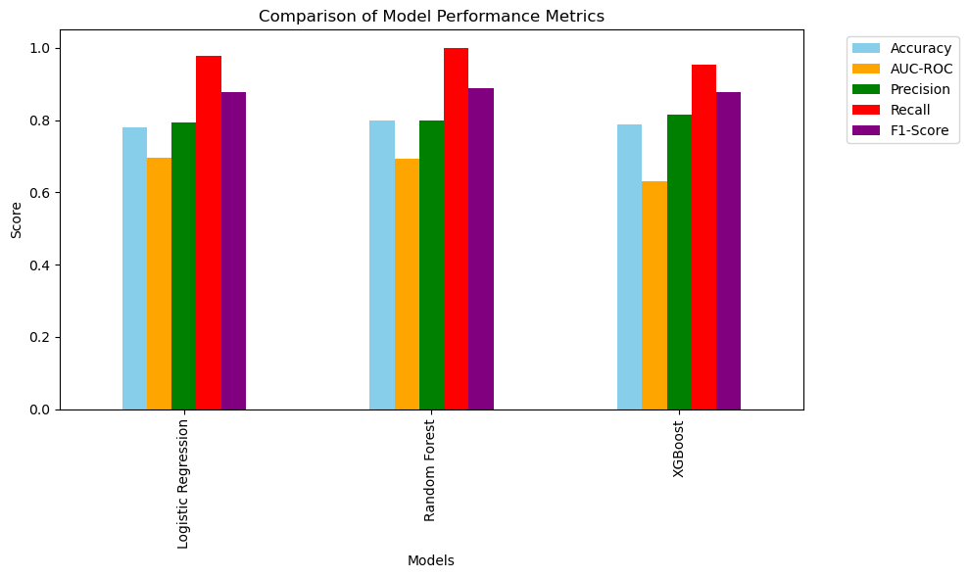
Model Comparison
Model Comparison 2
The comparison below shows the 3 primary models with their relative scores on the 5 Evaluation Metrics.
It can be seen that the AUC-ROC is the primary differentiator between the results thus this metric will be further evaluated.

Slide 12
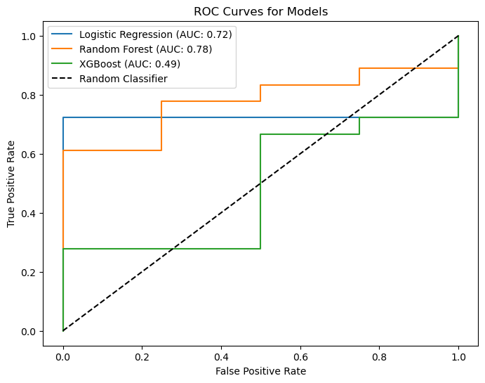
Model Comparison
Model Comparison 3
The ROC Curve comparison below shows the relative performance of each modeling methodology.
Logistic Regression shows a case of relative underfitting
XGBoost has good results but appears to reflect overfitting with a high prevalence of False Positives
Random Forest was selected as the most effective model for stroke prediction, based on its high recall, precision, and AUC-ROC score. It was particularly effective in:
Identifying a high percentage of actual stroke cases (high recall).
Maintaining reliable predictions with a balanced precision and F1-score.

Slide 13
Conclusion
Conclusion
This project successfully predicted stroke occurrences using a dataset of clinical and demographic features.
The Random forest model emerged as the best-performing algorithm, achieving high recall and a robust AUC-ROC score.
This work highlights the importance of a systematic approach to preprocessing, feature selection, and model evaluation in healthcare predictive systems.
While these models are not definitive in their predictions, they could be used as a tool to help aid in decision making for the TAVR procedure.

Slide 14
Challenges
The small dataset provided a limited number of records that made it difficult to divide the data into separate training sets and testing sets.
This also minimized the efficacy of methods such as Neural Networks.
Small number of positive results (complications) to learn from.
Inconsistent data and descriptions of negative outcomes must be accounted for and corrected prior to analysis to prevent biasing the model.
Managing the significant class imbalance required experimentation with oversampling and threshold adjustment techniques.
High correlation among features necessitated feature selection to improve model interpretability.

Slide 15
Final Thoughts
Final Thoughts
Precedent for prediction modeling to determine surgical outcomes has been established by groups such as the American Society of Anesthesiologists (ASA).
Their development and use of the American College of Surgeons National Surgical Quality Improvement Program (ACS-NSQIP) physical status classification score based on preoperative questionnaires.
It provides a system for hospitals and surgical practices to track and improve surgical outcomes using standardized data collection and benchmarking.
The model is built using data from over 4.3 million operations in the ACS NSQIP database.
The result of the model shows that patient’s risk of having any of 18 different complications within the first 30-days following surgery.
Future work related to this project could explore deep learning models or ensemble stacking for enhanced performance.
Incorporating domain knowledge into feature engineering, such as interaction terms, may further improve predictions.
Further evaluation considers the weighting of the false results
False positive may cause unwarranted cost or concern
False negative could lead to negative patient outcomes and perception
American College of Surgeons. 2024. ACS NSQIP Risk Calculator: Frequently Asked Questions. American College of Surgeons. https://riskcalculator.facs.org/RiskCalculator/faq.html

